Slide 1
NS– Network Simulator
(http://www.isi.edu/nsnam)

Slide 2
Content
Overview
Documentation
Basic Information
  Download
  Installation and Starting
OTcl – The user language
Simple simulation
  Trace analysis example
  Creating output files for Xgraph
Basic Components

Slide 3
NS Overview
Event-driven network simulator developed by UC Berkeley
Implements protocols such as TCP and UPD, traffic source behavior such as FTP, Telnet, Web, CBR and VBR, router queue management mechanism such as Drop Tail, RED and CBQ, routing algorithms such as Dijkstra, and more.
NS also implements multicasting and some of the MAC layer protocols for LAN simulations.

Slide 4
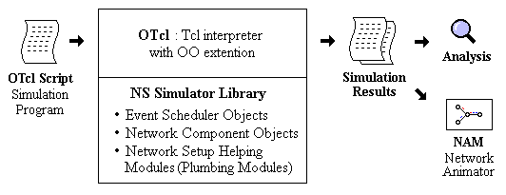
NS Overview (cont)
Simplified User's View of NS

Slide 5
Documentation
NS and nam (http://www.isi.edu/nsnam)
  NS Manual, man page, Nam user manual, NS Tutorial, NS Workshop notes
Tcl
  Tcl/Tk 8.0 manual http://www.elf.org/tcltk-man-html/contents.htm
C++
  The C++ Programming Language by Bjarne Stroustrup

Slide 6
Basics – downloading and starting
all-in-one package (unix/linux only)
  http://www.isi.edu/nsnam/dist/
  gcc32 installed on your system? (gcc –v)
NS-users mailing list
  http://www.isi.edu/nsnam/ns/ns-lists.html
Starting
  ns <tclscript>
  nam <namfile>

Slide 7
After installation Notes
gedit ~/.bashrc &-
LD_LIBRARY_PATHOTCL_LIB=/home/selda/ns-allinone-2.35/otcl-1.13NS2_LIB=/home/selda/ns-allinone-2.35/libX11_LIB=/usr/X11R6/libUSR_LOCAL_LIB=/usr/local/libexport LD_LIBRARY_PATH=$LD_LIBRARY_PATH:$OTCL_LIB:$NS2_LIB:$X11_LIB:$USR_LOCAL_LIB# TCL_LIBRARYTCL_LIB=/home/selda/ns-allinone-2.35/tcl8.4.18/libraryUSR_LIB=/usr/libexport TCL_LIBRARY=$TCL_LIB:$USR_LIB# PATHXGRAPH=/home/selda/ns-allinone-2.35/ns-allinone-2.35/bin:/home/selda/ns-allinone-2.35/tcl8.4.18/unix:/home/selda/ns-allinone-2.35/tk8.4.18/unixNS=/home/selda/ns-allinone-2.35/ns-2.35/NAM=/home/selda/ns-allinone-2.35/nam-1.15/PATH=$PATH:$XGRAPH:$NS:$NAM
------------------------------------------
-$ source ~/.bashrc
-----------------------
validation suite: $ cd ns-2.34
$ ./validate

Slide 8
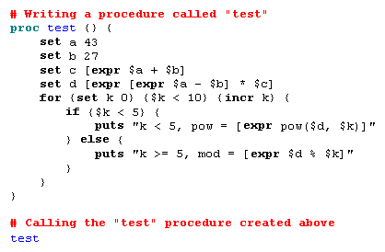
OTcl – the user language
Sample TCL script
Notes:
Example 1 is a general Tcl script that shows how to create a procedure and call it, how to assign values to variables, and how to make a loop. Knowing that OTcl is Object-orieneted extension of Tcl, it is obvious that all Tcl commands work on OTcl - the relationship between Tcl and Otcl is just same as C and C++. To run this script you should download ex-tcl.tcl, and type "ns ex-tcl.tcl" at your shell prompt - the command "ns" starts the NS (an OTcl interpreter). You will also get the same results if you type "tcl ex-tcl.tcl", if tcl8.0 is installed in your machine.
In Tcl, the keyword proc is used to define a procedure, followed by an procedure name and arguments in curly brackets. The keyword set is used to assign a value to a variable. [expr ...] is to make the interpreter calculate the value of expression within the bracket after the keyword. One thing to note is that to get the value assigned to a variable, $ is used with the variable name. The keyword puts prints out the following string within double quotation marks. The following shows the result of Example 1.

Slide 9
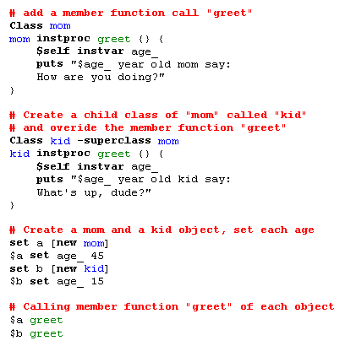
Notes:
The next example is an object-oriented programming example in OTcl. This example is very simple, but shows the way which an object is created and used in OTcl. As an ordinary NS user, the chances that you will write your own object might be rare. However, since all of the NS objects that you will use in a NS simulation programming, whether or not they are written in C++ and made available to OTcl via the linkage or written only in OTcl, are essentially OTcl objects, understanding OTcl object is helpful.
Example 2 is an OTcl script that defines two object classes, "mom" and "kid", where "kid" is the child class of "mom", and a member function called "greet" for each class. After the class definitions, each object instance is declared, the "age" variable of each instance is set to 45 (for mom) and 15 (for kid), and the "greet" member function of each object instance is called. The keyword Class is to create an object class and instproc is to define a member function to an object class. Class inheritance is specified using the keyword -superclass. In defining member functions, $self acts same as the "this" pointer in C++, and instvar checks if the following variable name is already declared in its class or in its superclass. If the variable name given is already declared, the variable is referenced, if not a new one is declared. Finally, to create an object instance, the keyword new is used as shown in the example

Slide 10
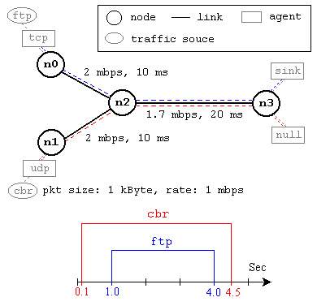
Simple simulation
Notes:
This network consists of 4 nodes (n0, n1, n2, n3) as shown in above figure. The duplex links between n0 and n2, and n1 and n2 have 2 Mbps of bandwidth and 10 ms of delay. The duplex link between n2 and n3 has 1.7 Mbps of bandwidth and 20 ms of delay. Each node uses a DropTail queue, of which the maximum size is 10. A "tcp" agent is attached to n0, and a connection is established to a tcp "sink" agent attached to n3. As default, the maximum size of a packet that a "tcp" agent can generate is 1KByte. A tcp "sink" agent generates and sends ACK packets to the sender (tcp agent) and frees the received packets. A "udp" agent that is attached to n1 is connected to a "null" agent attached to n3. A "null" agent just frees the packets received. A "ftp" and a "cbr" traffic generator are attached to "tcp" and "udp" agents respectively, and the "cbr" is configured to generate 1 KByte packets at the rate of 1 Mbps. The "cbr" is set to start at 0.1 sec and stop at 4.5 sec, and "ftp" is set to start at 1.0 sec and stop at 4.0 sec.

Slide 11
Simple simulation - template
#Create a simulator object
set ns [new Simulator]
#Open the NAM trace file
set nf [open out.nam w]
$ns namtrace-all $nf
#Define a 'finish' procedure
proc finish {} {
global ns nf
$ns flush-trace
#Close the NAM trace file
close $nf
#Execute NAM on the trace file
exec nam out.nam &
exit 0
}

Slide 12
Simple simulation – template (cont)
#Call the finish procedure after 5 seconds of simulation time
$ns at 5.0 "finish"
#Run the simulation
$ns run

Slide 13
Simple simulation – creating network
#Create four nodes
set n0 [$ns node]
set n1 [$ns node]
set n2 [$ns node]
set n3 [$ns node]
#Create links between the nodes
$ns duplex-link $n0 $n2 2Mb 10ms DropTail
$ns duplex-link $n1 $n2 2Mb 10ms DropTail
$ns duplex-link $n2 $n3 1.7Mb 20ms DropTail
#Set Queue Size of link (n2-n3) to 10
$ns queue-limit $n2 $n3 10

Slide 14
Simple simulation – creating agents - FTP
#Setup a TCP connection
set tcp [new Agent/TCP]
$tcp set class_ 2
$ns attach-agent $n0 $tcp
set sink [new Agent/TCPSink]
$ns attach-agent $n3 $sink
$ns connect $tcp $sink
$tcp set fid_ 1
#Setup a FTP over TCP connection
set ftp [new Application/FTP]
$ftp attach-agent $tcp
$ftp set type_ FTP

Slide 15
Simple simulation – creating agents - CBR
#Setup a UDP connection
set udp [new Agent/UDP]
$ns attach-agent $n1 $udp
set null [new Agent/Null]
$ns attach-agent $n3 $null
$ns connect $udp $null
$udp set fid_ 2
#Setup a CBR over UDP connection
set cbr [new Application/Traffic/CBR]
$cbr attach-agent $udp
$cbr set type_ CBR
$cbr set packet_size_ 1000
$cbr set rate_ 1mb
$cbr set random_ false

Slide 16
Simple simulation – starting traffic
#Schedule events for the CBR and FTP agents
$ns at 0.1 "$cbr start"
$ns at 1.0 "$ftp start"
$ns at 4.0 "$ftp stop"
$ns at 4.5 "$cbr stop"

Slide 17
Simple simulation – NAM settings
#Give node position (for NAM)
$ns duplex-link-op $n0 $n2 orient right-down
$ns duplex-link-op $n1 $n2 orient right-up
$ns duplex-link-op $n2 $n3 orient right
#Monitor the queue for link (n2-n3). (for NAM)
$ns duplex-link-op $n2 $n3 queuePos 0.5

Slide 18
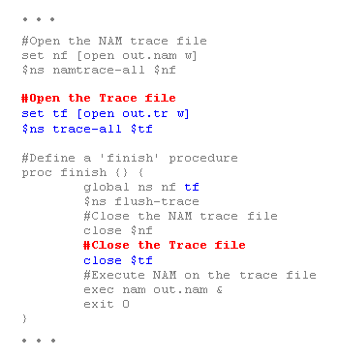
Trace analysis example

Slide 19
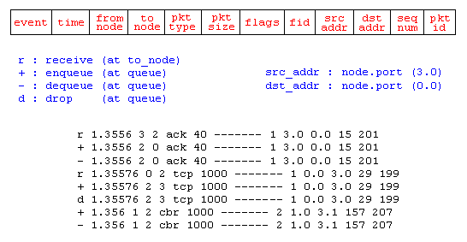
Trace analysis example - format
Notes:
Each trace line starts with an event (+, -, d, r) descriptor followed by the simulation time (in seconds) of that event, and from and to node, which identify the link on which the event occurred. Look at Figure 9 in the "Network Components" section to see where in a link each type of event is traced. The next information in the line before flags (appeared as "------" since no flag is set) is packet type and size (in Bytes). Currently, NS implements only the Explicit Congestion Notification (ECN) bit, and the remaining bits are not used. The next field is flow id (fid) of IPv6 that a user can set for each flow at the input OTcl script. Even though fid field may not used in a simulation, users can use this field for analysis purposes. The fid field is also used when specifying stream color for the NAM display. The next two fields are source and destination address in forms of "node.port". The next field shows the network layer protocol's packet sequence number. Note that even though UDP implementations do not use sequence number, NS keeps track of UDP packet sequence number for analysis purposes. The last field shows the unique id of the packet.

Slide 20
Creating output files for XGraph
$ns at 0.0 "record"
proc record {} {
global sink0 f0
#Get an instance of the simulator
set ns [Simulator instance]
#Set the time after which the procedure should be called again
set time 0.5
#How many bytes have been received by the traffic sinks?
set bw0 [$sink0 set bytes_]
#Get the current time
set now [$ns now]
#Calculate the bandwidth (in MBit/s) and write it to the files
puts $f0 "$now [expr $bw0/$time*8/1000000]"
#Reset the bytes_ values on the traffic sinks
$sink0 set bytes_ 0
#Re-schedule the procedure
$ns at [expr $now+$time] "record"
}

Slide 21
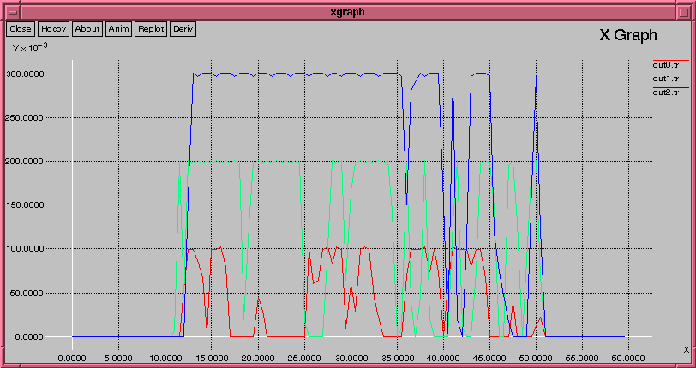
Creating output files for Xgraph (cont)
exec xgraph out0.tr out1.tr out2.tr -geometry 800x400 &

Slide 22
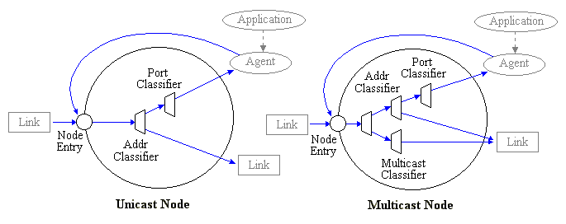
Basic components - node
Notes:
A node is a compound object composed of a node entry object and classifiers as shown in Figure 7. There are two types of nodes in NS. A unicast node has an address classifier that does unicast routing and a port classifier. A multicast node, in addition, has a classifier that classify multicast packets from unicast packets and a multicast classifier that performs multicast routing.

Slide 23
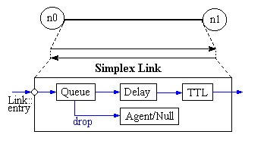
Basic components - link
Notes:
A link is another major compound object in NS. When a user creates a link using a duplex-link member function of a Simulator object, two simplex links in both directions are created as shown in Figure 8.
A node is a compound object composed of a node entry object and classifiers as shown in Figure 7. There are two types of nodes in NS. A unicast node has an address classifier that does unicast routing and a port classifier. A multicast node, in addition, has a classifier that classify multicast packets from unicast packets and a multicast classifier that performs multicast routing.

Slide 24
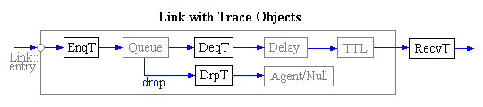
Basic components – link - tracing
Notes:
In NS, network activities are traced around simplex links. If the simulator is directed to trace network activities (specified using $ns trace-all file or $ns namtrace-all file), the links created after the command will have the following trace objects inserted as shown in Figure 9. Users can also specifically create a trace object of type type between the given src and dst nodes using the create-trace {type file src dst} command.
When each inserted trace object (i.e. EnqT, DeqT, DrpT and RecvT) receives a packet, it writes to the specified trace file without consuming any simulation time, and passes the packet to the next network object. The trace format will be examined in the General Analysis Example section.

Slide 25
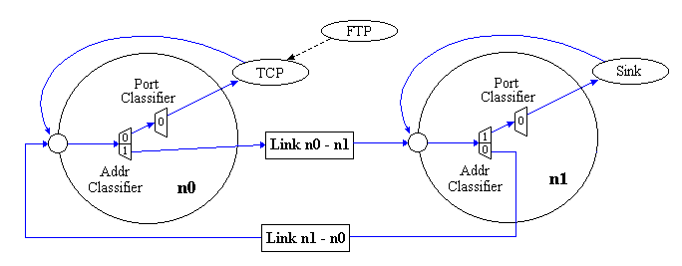
Basic components – packet flow example

Slide 26
. . : : Thanks : : . .
http://www.isi.edu/nsnam
  Distribution
    Source code
    Example tcl
    Validation scripts
  Manual
  ns-users mailing list

Slide 27
Some Other References
[nsForBginners] “ns Simulator for Beginners, Lecture Notes 2003-2004”, Univ. de Los Andes, Merida, Venezuela and ESSI, Sophia-Antipolice, France, http://www-sop.inria.fr/maestro/personnel/Eitan.Altman/ns.htm, December 3, 2003.
[nsManual] “ns Notes and Documentation”, The VINT Project, http://www.isi.edu/nsnam/ns/ns-documentation.html, December 2008.
[nsOfficialSite] http://www.isi.edu/nsnam/ns/
[MarcGreis’TutForNs] “Tutorial for Network Simulator ns”, Marc Greis, The VINT Project, http://www.isi.edu/nsnam/ns/tutorial/nsintro.html

